Slide 1
Using Automated Software Engineering Methods for Program Evaluation
Jayendran (SMT2014009)

Slide 2
Contents
Problem Statement
Mutation Testing
Program Dependence Graph
Sketch Synthesizer
Existing Approach
Proposed Approach
References

Slide 3
Problem Statement
Automated Evaluation of programs based on Software Engineering Techniques
Evaluation of student submissions for a programming exercise is a fairly complex process
Many solutions are possible
Different student’s might follow different approaches
Examiner has to understand the student’s approach and evaluate the student’s solution
Solutions can be verified by running set of test cases on every solution

Slide 4
Problem Statement
Evaluation based on number of test cases passed is unfair
Evaluation should be based on Error criticality
Evaluation should be done based on cost of correcting the student solution
Identify the type of Errors beforehand
Even if output is correct, algorithm might be incorrect
For Merge sort question, quick sort is implemented

Slide 5
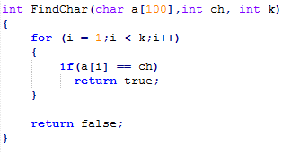
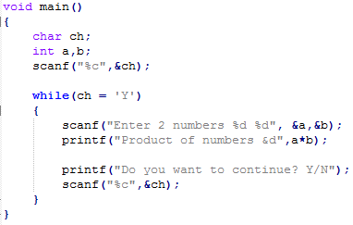
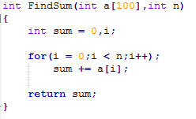
Problem Statement
Types of Errors
Perfect Algorithm but compilation error due to small mistake
Uninitialized/Incorrectly initialized variables
Incorrect loop range
Corner cases
Missing else conditions

Slide 6
Mutation Testing
A structural, white box testing method
Mutant Testing is used to verify the quality of test cases
Mutant Programs are generated using Mutation operators
Testcases are run on Mutant programs and verified if output is same as original program.
If some testcase fails then Mutants are killed (meaning good testcases)
If the test suite kills all the Mutants then we have a good test suite

Slide 7
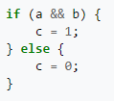
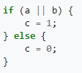
Mutation Testing
For a Mutant to get “killed”
A test must reach the mutated statement.
Test input data should infect the program state by causing different program states for the mutant and the original program. Above example, a test with a = 1 and b = 0 would do this.
The incorrect program state (the value of 'c') must propagate to the program's output and be checked by the test.
Strong Mutation – All 3 conditions are satisfied
Weak Mutation – Only first 2 conditions are satisfied. Used for code coverage checking
Normal Program
Mutant Program

Slide 8




Mutation Testing
Mutation Types
Value Mutation : Change the values of variable assignments or constants
Decision Mutation : Change the flow of the program
Statement Mutation : Deleting or Duplicating statements of the program
Mutation Tools – MuJava (https://cs.gmu.edu/~offutt/mujava/), Insure++,Jumble

Slide 9
Program Dependence Graph (PDG)
Program Dependence Graph
Vertices in the graph corresponds to program statements
Edges give information of various control and data dependencies between every vertices (program statements)
PDG’s are often used for optimizing programs
Types of dependencies in PDG
Control Dependencies – modifies the control flow of program (if/while/for statements)
Data Dependencies – reading memory locations (accessing values of variables)
Address Dependencies – writing memory locations (assigning values to variables)

Slide 10
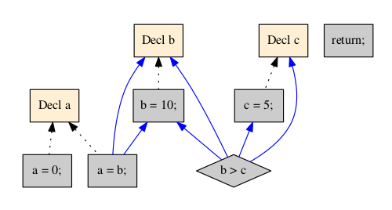
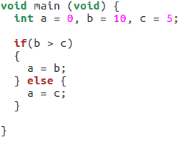
PDG (Example 1)
Data
Address
Data + Address
Control

Slide 11
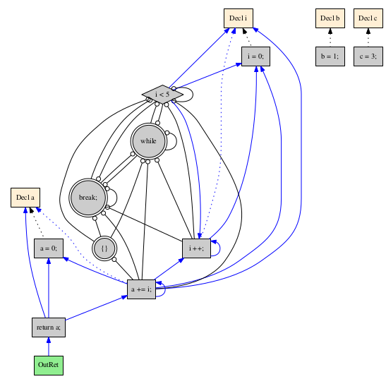
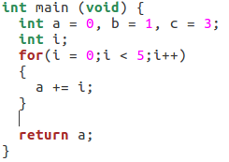
PDG (Example 2)
Data
Address
Data + Address
Control

Slide 12
Program Dependence Graph (PDG)
Frama-c – Framework to analyze C source code
PDG plugin can be used to extract PDG of code
http://frama-c.com/
Code Sonar/Surfer from Grammatech

Slide 13
Program Synthesis
Automatically construct a program that satisfies a high-level specification
Useful in several scenarios
Discovering new Algorithms
Correcting user programs
Developing scripts for performing repetitive tasks
Specifications can be in the form of statements which indicates an expected output value to be satisfied on performing the synthesis

Slide 14


Sketch Synthesizer
Program Synthesizer
sketch
implementation (completed sketch)

Slide 15
Sketch Synthesizer
Programs are written in Sketch language
Partial programs are written with holes (??)
Sketch tries to find values of holes based on the given constraints (output values to be satisfied) and completes the program
If constraints cannot be satisfied throws error
Uses Counter Example Guided Inductive Synthesis (CEGIS) algorithm

Slide 16
Sketch Synthesizer
Specifications constrains the program behavior
Assertions are introduced
assert x == 100;
Functional Equivalence
SynthesizeMatMul(Mat A,Mat B) implements matMul
Holes are placeholder for synthesizer
Synthesizer replaces/tries to find values for the holes
Range for the search space can be specified (Ex. No of bits for integer search range)

Slide 17


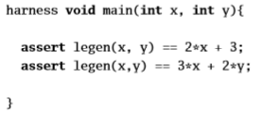


Sketch Synthesizer
Sketch Program
Synthesized Output
Generator Functions – Describes a space of possible code fragments to fill a hole

Slide 18
Existing Approach
QLOSE Tool
Automatically corrects programs based on Syntactic and Semantic distances
Uses Sketch tool for finding solutions
QLOSE tool transforms student’s program into Sketch programs and tries to solve it
Hard constraints (set of testcases to be passed) and Soft constraints (syntactic and semantic distances)

Slide 19
Existing Approach
Syntactic Distance
Expression Distance - Syntactic difference between expression
Boolean Expression distance (tracks if expressions equal or not)
Expression Size distance (tracks size of repaired expression)
Semantic Distance
Execution Distance – Tracks differences between executions
Concrete Execution distance (compares both locations and variables)
Value Execution distance (compares only variable values)
Location Execution distance (compares only locations)

Slide 20
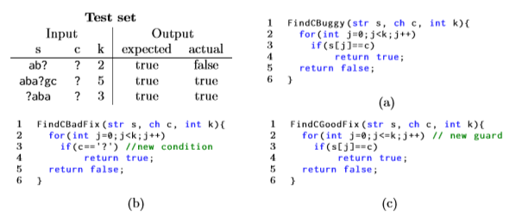
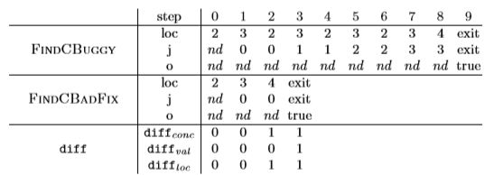
Existing Approach

Slide 21
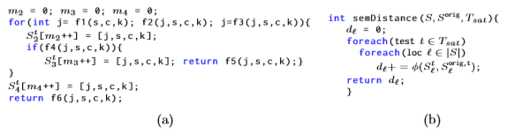

Existing Approach
Encoding Semantic Distance in Sketch
Modified Program satisfies

Slide 22
Proposed Approach
Golden Standard Computation
Set of Solutions which pass all the test cases are added as a Golden Standard (G)
All the solutions in G are semantically distinct
Wrong Solutions are excluded (even if they pass the testcases)
Nearest Neighbor Computation
Every student solution (Ps) is compared with elements of G and nearest neighbor(Pg) is identified i.e Student’s approach is identified
PDG’s can be generated for the solutions in G and Ps
Graph Isomorphism can be used to filter/match the PDG’s and identify Pg

Slide 23
Proposed Approach
Semantic Distance Computation
State/Values of live variable at every location (within scope) of the program is calculated
Mutation Based Approach
Student solution (Ps) is transformed into another program (Ps’) using mutation operator
Mutation operators are identified based on Pg identified
Semantic distance is calculated between Ps and Ps’
Many corrections (Ps’) possible. Solution with minimum cost is picked
Trace Based Approach
Different inputs are given to Pg & Ps and semantic distance is calculated
Renaming of variable of Ps to match Pg might be required

Slide 24
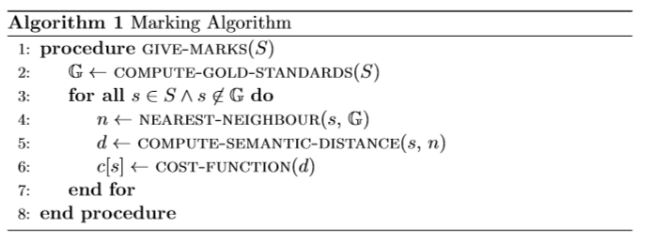
Proposed Approach

Slide 25
References
Qlose: Program Repair with Quantitative Objectives
GPLAG: Detection of Software Plagiarism by Program Dependence Graph Analysis
Automated Feedback Generation for Introductory Programming Assignments

